Slide 1
Fall 2015 NJ/DV HIMSS Conference
Innovation Centers: From Hackensack University Medical Center’s The Experience Lab to Innovation Centers Across the Country
Fall 2015 NJ/DV HIMSS Conference
Mike Squires, VP, Innovation & Public Policy BluePrint Healthcare IT

Slide 2
Abstract
Hackensack University Medical Center started its innovation center—The Experience Lab-- in 2014 to collaborate and experiment in real clinical environments on innovative information technology solutions. The session will share how HackensackUMC’s innovation center is working with internal and external partners to provide world-class clinician and patient experience driving the highest quality customer service and exceptional patient care in a fiscally responsible manner. BluePrint Healthcare IT Innovation Exchange (BIX) will provide the context innovation centers are playing in healthcare systems nationally and internationally. BluePrint has learned from nearly 70 healthcare innovation centers who have participated in a series of five Innovation Centers Summit Workshops including those held at Kaiser Permanente’s Innovation Centers, Mayo Clinic Center for Innovation, Johns Hopkins Center for Bioengineering Innovation and Design and The Innovation Institute. Additional insights will be provided from a Webinar and survey conducted by The Commonwealth Fund.

Slide 3
HackensackUMC Innovation
Live Experience Labs
Fall 2015 NJ/DV HIMSS Conference
Shafiq Rab, M.D., MPH
Vice President, Chief Information Officer
Hackensack University Medical Center
Jeremy A. Marut, MBA, CHCIO
Director of Enterprise Architecture
Hackensack University Medical Center

Slide 4
About Hackensack University Health Network
A nonprofit teaching and research hospital located in Bergen County, NJ
The largest provider of inpatient and outpatient services in the state.
One of the largest health networks in the state comprised of 1,140 beds, nearly 10,000 employees and 2,200 credentialed physicians.
#1 hospital in New Jersey and one of the top four New York metro area by the U.S. News & World
Healthgrades® America’s Best 100 Hospitals in 10 different areas – more than any other hospital in the nation
Healthgrades America's 50 Best Hospitals™ for seven years in a row
Healthgrades Distinguished Hospital Award for Clinical Excellence™ 11 years in a row
Leapfrog Top Hospital
23 Gold Seals of Approval™ by the Joint Commission – more than any other hospital in the country.
First hospital in New Jersey and second in the nation to become a Magnet® recognized
HackensackUMC is the Hometown Hospital of the New York Giants and the New York Red Bulls www.HackensackUMC.org

Slide 5
Healthcare will only change when we as patients want it to change. - Shafiq Rab, MD

Slide 6
Patient & Clinician Experience
Crossing the Convenience Chasm
Meaningful
Focus on Experience
Pleasurable
Convenient
Many organizations caught in this chasm
Usable
Reliable
Focus on
Tasks
Functional

Slide 7
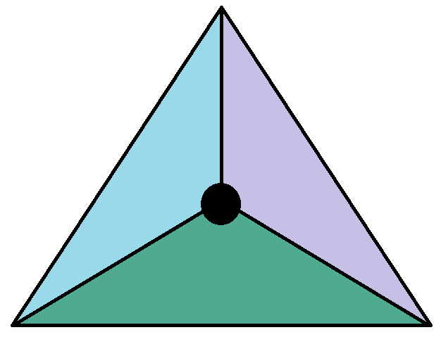
Achieving the Triple Aim
Making a Difference with Technology
Improving
Patient
Experience
Reducing
Cost
Improving
Outcomes

Slide 8
Live Experience Labs
Clinician and Patient Technology Trials
Clinician & patient driven
NOT an IT initiative
Two inpatient nursing units
Already successful ones
Two outpatient faculty practice offices
Engaged ones

Slide 9
Live Experience Labs
The Participants
Leadership
There must be a vision for innovation
Technology steering committee
Physicians
Nursing
Clinical Operations (anyone who has a need)
Infection Control
The vendors
Patients & their families
Information Technology

Slide 10
Live Experience Labs
The Process
Evaluate Needs & Opportunities
Brainstorm Workflows
Brainstorm Accommodating Technology
Bring in Vendors
Develop Solution
Internal non-Prod Pilot
Live POC in Labs
Continued Refinement
Evaluate Success/Outcomes
Campus Go/No-Go Decision

Slide 11
Live Experience Labs
Results & Guidelines
8 technologies introduced in 2015 will be adopted house-wide in 2016
Align with the organization
There needs to be a need
Keep the fire stoked
Continuous nurse & doctor feedback
Continuous patient rounding
All or nothing technology?
Physicians can’t be targeted, they practice everywhere

Slide 12
Thank You
Contact or Follow Dr. Shafiq Rab
551-996-3669
Srab@HackensackUMC.org
@CIOSHAFIQ

Slide 13
Fall 2015 NJ/DV HIMSS Conference
Learnings from
Healthcare Innovation Centers: Based on Five Innovation Centers Summit Workshops
produced by BluePrint Innovation Exchange
Mike Squires, VP, Innovation & Public Policy BluePrint Healthcare IT
Innovation Centers Summit Workshops Five since 2012
© 2015 BluePrint Healthcare IT. All rights reserved.

Slide 14
Forces that influence
adoption and spread of health care innovation
Source: AHRQ Innovation Exchange: Understanding the Forces That Influence the Adoption and Spread of Health Care Innovation
BySusan Dentzer, MA, Senior Policy Adviser to the Robert Wood Johnson Foundation; Member, Innovations Exchange Expert Panel

Slide 15
Health Care Delivery Innovation Center
Definition
“places that are working to discover, develop, test, and/or spread new models of care delivery—in hospitals, clinics, and patients’ homes. The innovations they test may be internally developed or adopted from elsewhere.”
Source: The Commonwealth Fund Findings from a Survey of Health Care Delivery Innovation Centers April 2015

Slide 16
Health Care Delivery Innovation Centers Overview
Question | Range of Responses | Median
Year started | 1995–2014 | 2010
Annual budget (when disclosed) | $150,000–$18,000,000 | $1,950,000
Number of staff (full-time equivalents) | 1–215 | 6
Time spent testing an innovation | 1 week–3 years | 3–12 months
Number of innovations being tested | 2–100 | 12.5
Time horizon for funding | 1 year–10 years | 1 year
Source: The Commonwealth Fund Findings from a Survey of Health Care Delivery Innovation Centers April 2015
Note: Number of innovation center respondents varied from 21 to 32, depending on the question.

Slide 17
What do innovation centers do?
Source: The Commonwealth Fund Findings from a Survey of Health Care Delivery Innovation Centers April 2015

Slide 18
What do innovation centers focus on?
Notes: Percentages based on 31 innovation center respondents. Other responses include spending reductions, the uninsured, helping seniors age in place, teaching/education, data mining, and data analysis.
Source: The Commonwealth Fund Findings from a
Survey of Health Care Delivery Innovation Centers April 2015

Slide 19
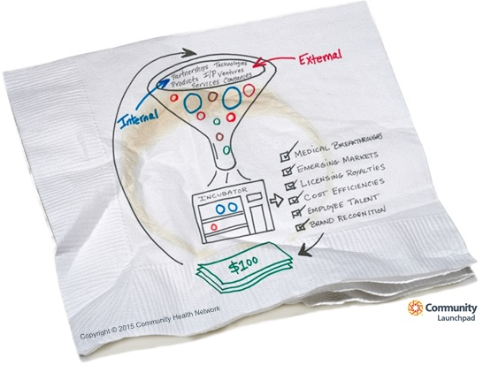
Innovation Frameworks (Process)
Frameworks
Funnel Linear Double Triangle Circular Spiral
Funnel
Source:
Community Launchpad / Community Health Network, Indiana

Slide 20
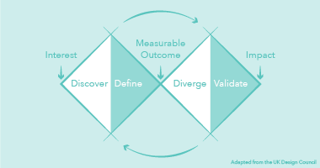
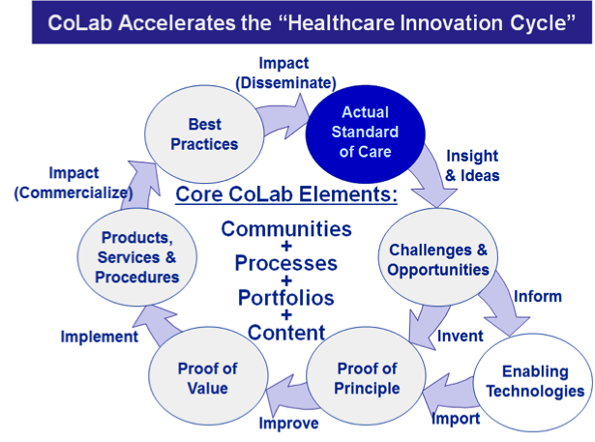
Innovation Frameworks (Process)
UCLA Institute for Innovation in Health
Penn Medicine Center for Health Care Innovation
Linear | Double Triangle
Circular | Spiral
CIMIT Center for Integration of Medicine
and Innovative Technology
Johns John Hopkins CBID
Center for Bioengineering Innovation & Design
Source: Innovation Centers Summit Workshop Series, Nov 2013 to Nov 2015, Penn Medicine Center for Health Care Innovation

Slide 21
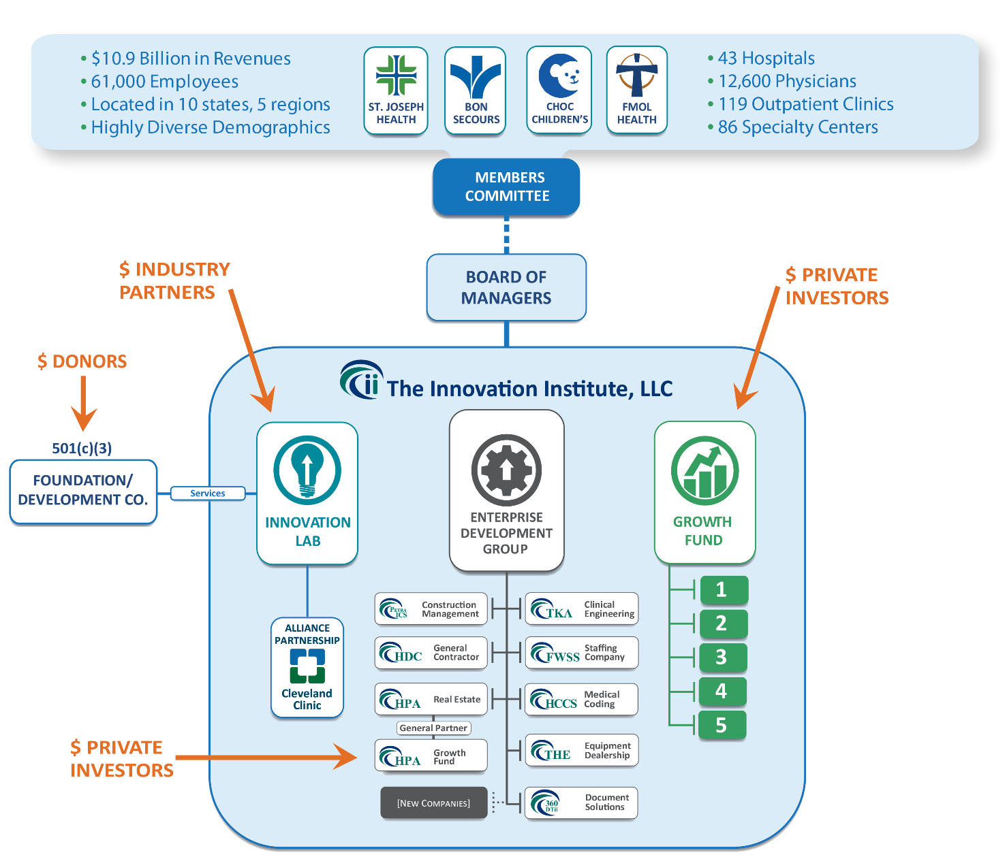
Hybrid Multi-System Innovation Structure
Source: The Innovation Institute

Slide 22
Innovation Engagement Models
C-suite: Trinity Health
Clinicians: Boston Children’s Hospital IAP
Patients:
Mayo Clinic Center for Innovation
External Partners:
Harvard Medical School
Center for Primary Care/InciteHealth
Innovation Council
Workgroups – Champions IT – Regions - Other
Innovators’ Showcase Digital/MedTech Work Groups
Hackathons I-Day Forums
Optimized Care Teams Nurse Visits – Phone Visits Touches v. Visits
Ex: Donor, Advisors & Mentors Instructor, Patients
In: Dean, Center for Primary Care
HBS, iLab, Tech Transfer
Source: Fifth Innovation Centers Summit Workshop Engagement Panel May 2015 – Located at Mayo Center for Innovation, Rochester, MN

Slide 23
Thank you!
Contact:
Mike Squires, VP, Innovation & Public Policy BluePrint Healthcare IT
mike.squires@blueprinthit.com
908.391.6191
www.blueprinthit.com/innovation
Innovation Centers Summit Workshops Five since 2012

Slide 24
Q & A
Shafiq Rab, MD, MPH
Srab@HackensackUMC.org
Jeremy Marut
JMarut@HackensackUMC.org
Mike Squires
mike.squires@blueprinthit.com
@CIOShafiq
@eMikeSquires
Innovation Centers Summit Workshops Five since 2012
@DirectorMarut

