Slide 1
Analytics Beyond the EMR
Omni-HealthData™
Big Data Governance, Enabling Technologies, and Cutting Through the Hype
Shawn S. Sutherland, CPHIMS
Shawn_Sutherland@IBI.com
Manager, Patient and Member Outcomes
www.OmniHealthData.com

Slide 2



Hi, my name is Shawn, and….

Slide 3

Where to begin…

Slide 4
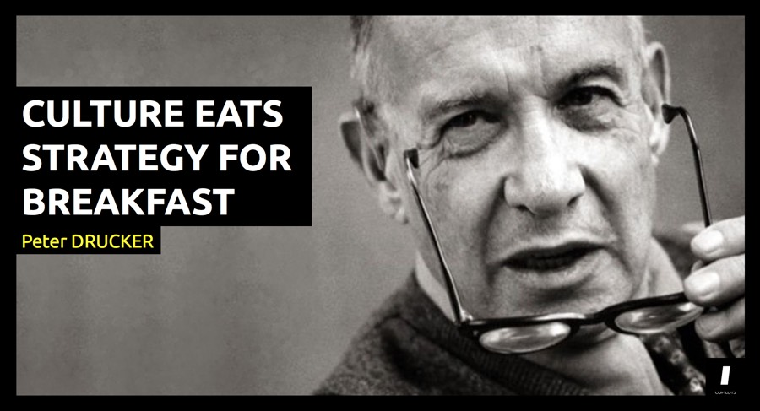
People 1st
(and technology for lunch)
Notes:
Providers – not for profits, academic medical centers, provider groups
Payers - $ is foremost, health is important
Canada – money is a bad word
Drucker - "the founder of modern management“, coined the phrase “knowledge worker” in 1959
What gets measured gets managed! - Drucker

Slide 5
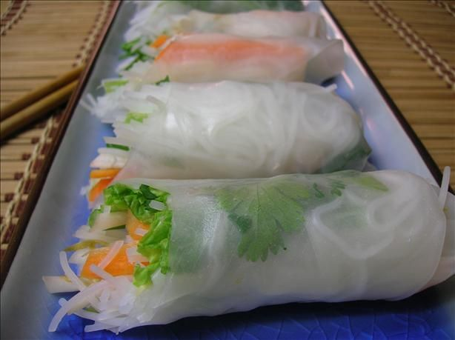
Define clear roles for the different stakeholders
IT
Business
Clinicians

Slide 6
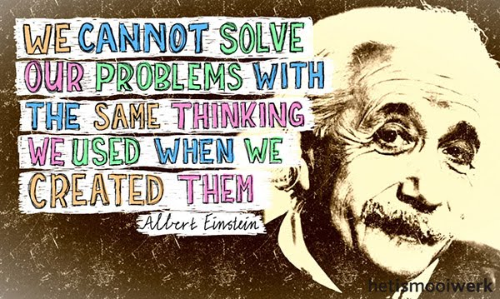
Data – must be treated as a valued asset

Slide 7

Inclusive Process – Nothing falls through the cracks

Slide 8

Upstream vs downstream management of data
Notes:
Story about 2 fisherman in a river

Slide 9
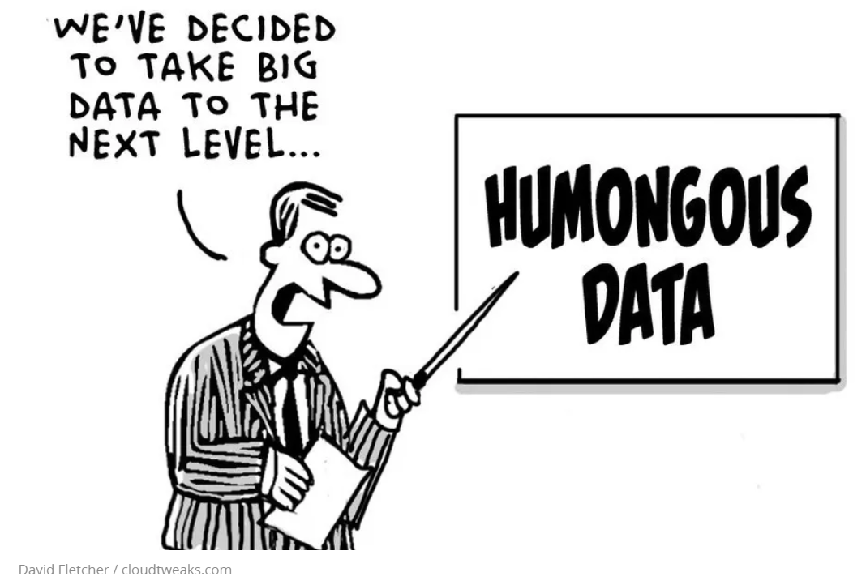
Big Data, really?

Slide 10

Avoid the hype – There are many choices for one decision and all can go different directions
Notes:
We have one of everything, 2 or 3 of some
Story reminder: Not chasing the shiny object

Slide 11
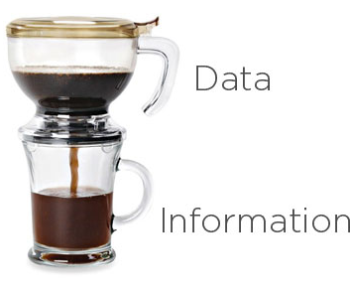
Cut through the HYPE – What is Big Data?
How we used to talk about Big Data in Healthcare
R ich
I nformation
P oor
D ata

Slide 12
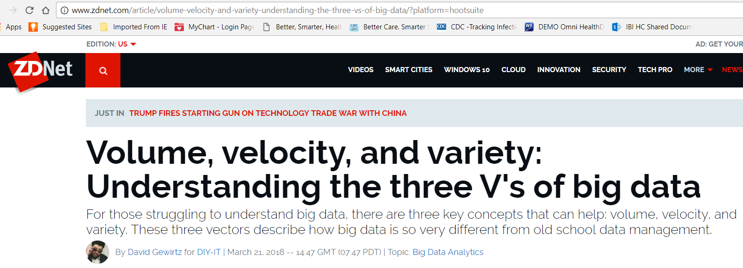
Cut through the HYPE – What is Big Data?
Modern definition

Slide 13













Healthcare Variety
Example #1 – extra easy
Patient Gender(22)
Omni-Patient
Patient Gender (6)
0 1
A | Ambiguous
F | Female
M | Male
N | Not applicable
O | Other
U | Unknown
M F T I N
2 3 4 99
MALE
FEMALE
UNKNOWN
TRANSGENDER
OTHER
01 02 03 05 09
Validation
Harmonization
Standardization
A B C D
N/A
<NULL>
Marital Status (16)
A | Separated
B | Unmarried
C | Common law
D | Divorced
E | Legally Separated
G | Living together
I | Interlocutory
M | Married
N | Annulled
O | Other
P | Domestic partner
R | Registered domestic partner
S | Single
T | Unreported
U | Unknown
W | Widowed
Marital Status (37)
Omni-Codes
01 02
MRD
LSP DIV OTHR NULL
,02S
03 04 05
06 07 99
Other Reference
MRD LSP DIV ALD OTR SGL DPR UNK WDW
MS_001
MS_002
MS_003
MS_004
A01 D01 M00 W04 D02 I01
S01 R01
Medical Terminology
2013_M1
2320_M2
Notes:
Dr. Jerzy Lysikowski – 80% of our time is spent managing organizing these types of data so they are fit for analysis

Slide 14
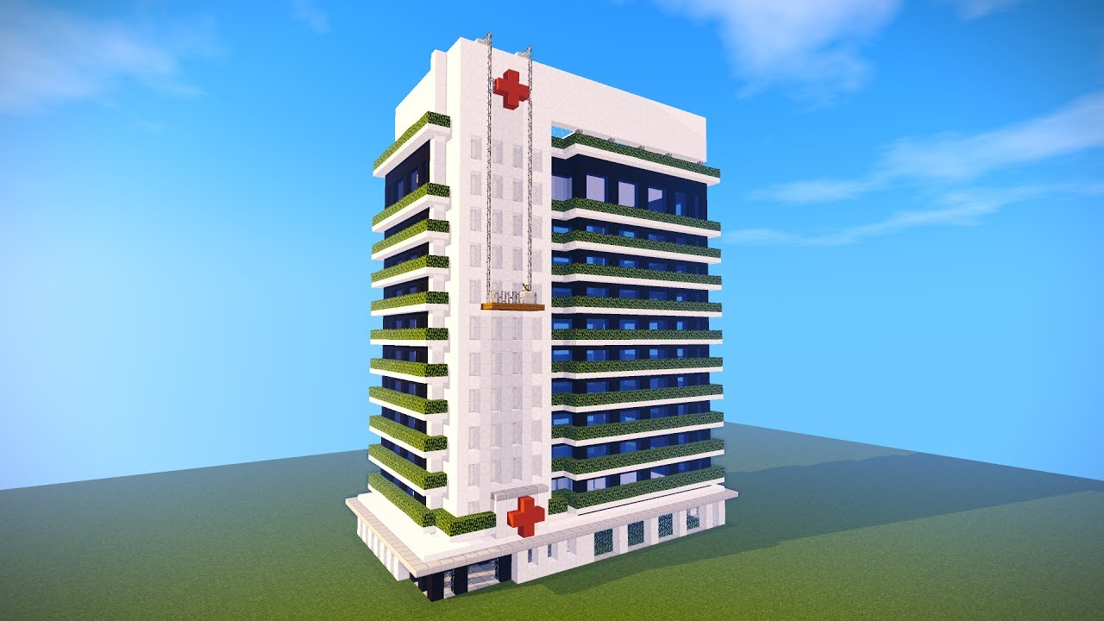
Healthcare Variety
Example #2 – Hospital, Unit, Bed – kind of easy?
Hospital
IBH of New York
IB and Jersey Medical Center
IBHealth Hospital of New York
IBJ Med Center
The IBHealth Medical Center
IBJ Medical Center
IBHealth Medical Center
IBJ NY
CMS Hospital Name
TIN Hospital Name
IBJ NY and Jersey….
Unit
Four North
Four-North
FourNorth
4 North
4-North
4_North
04North
04
4N
Bed
4N 420
4N-420
4 N 420
0420
RM_420
420
00420
N420
_0420
Notes:
Disheveled Data Scientist
Oh, yeah, did I mention we had 30 hospitals at the time

Slide 15
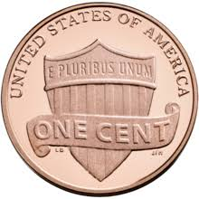
Healthcare Variety
Example #3 – Ok, ok, that’s hard!
  HLI Medical Specialty Subsets
  PQRS Subsets
  HLI Medical Specialty Subsets
  Nursing: NIC, NOC, NANDA
  HL7
  CDT
  UCUM
  UNI
  HRG
  CCI
  CVX, MVX
  Rev codes
  Multiple languages
Terminology Sets (partial list)
Mappings (partial list)
  SNOMED CT
  ICD-9-CM
  ICD-10-CM/PCS
  CPT-4
  Medical necessity
  Age/gender edits
  HCPCS
  APC
  MS-DRG, AP-DRG
  LOINC
  DSM IV
  Medications:
  RXNorm, FDB, NDC,
  NDF-RT, Medi-Span,
  Multum
  SNOMED CT to ICD-9-CM
  SNOMED CT to CPT
  SNOMED CT to MeSH
  SNOMED CT to ICD-10-CM/PCS
  ICD-9-CM to ICD-10-CM/PCS
  ICD-10-CM/PCS to ICD-9-CM
  ICD-9-CM to SNOMED CT
  ICD-10-CM to SNOMED CT
  CPT to SNOMED CT
  DSM IV to SNOMED CT
  RxNorm to NDF-RT
  CPT to CVX
Notes:
CIO story about banking

Slide 16
Big Data Environment Architecture

Slide 17
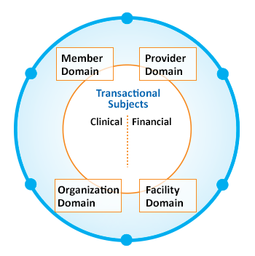
MDM platform leveraging Big Data for staging and consumption
| Pre-built data models for mastered and transactional domains | Pre-built processing, quality, mastering, and remediation rules |
| 360 Degree View on Members and Providers through Data and Analytics |
Data Lake
Analytic Data Staging Environment
Internal data
Member (e.g., Initiate)
Claims
Eligibility
External data
Member
Administrative
Clinical (CCD, HL7, etc.)
Facility
Provider info
Downstream apps
Provider relations
Claims adjudication
Analytics
Data warehouses
Data marts
External
Provider & member portals
Reimbursement
Subject Oriented Data On Ramp
Consumption:
HEDIS Grouper, CCD, views, etc.
Integrate, Cleanse,
Correlate, Steward
Reference
data
Code sets: HLI

Slide 18

Healthcare is collaborative by nature
Notes:
Competition and collaboration side by side

Slide 19



So, read THIS …and join THEM
Notes:
Competition and collaboration side by side

Slide 20
Analytics Beyond the EMR
Omni-HealthData™
Big Data Governance, Enabling Technologies, and Cutting Through the Hype
Shawn S. Sutherland, CPHIMS
Shawn_Sutherland@IBI.com
Manager, Patient and Member Outcomes
www.OmniHealthData.com

