Slide 1
2018 Future of Healthcare
WA HIMSS Presentation
Sri Rajamani,
Director, Solution Consulting at Health Catalyst
3.29.2018

Slide 2
Agenda
Is Healthcare Industry already Digital?
Digital Experience and Patient Interaction: ‘Data First’ vs ‘Process First’
Digital Experience Part 1 : Placing Orders
Digital Experience Part 2 : Scheduling Visits
Digital Experience Part 3 : Switching Provider Networks
What are the key drivers for Key drivers for ‘Data First’ Experience
Northwest Local Trend Spotting
Conclusions

Slide 3
EMRs
Various Digital Systems in Healthcare
Finance/Costing
Billing
HR/ERP
Claims
Clinical Specialty
Affinity - ADT/Registration
Allscripts - Ambulatory EMR Clinicals
Allscripts Enterprise/Touchworks - Ambulatory EMR
Allscripts Sunrise - Acute EMR Clinicals
Aprima ERM
Cerner - Acute EMR Clinicals
Cerner - PowerWorks Ambulatory EMR
Cerner HomeWorks - Other
CPSI - Acute EMR Clinicals
eClinicalWorks - Ambulatory EMR Clinicals
Epic - Acute EMR Clinicals
Epic - Ambulatory EMR Clinicals
GE (IDX) Centricity - Ambulatory EMR Clinicals
McKesson Horizon - Acute EMR Clinicals
McKesson Horizon Enterprise Visibility
Meditech 5.66 EHR w/DR
NextGen - Ambulatory Practice Management
Quality Systems (Next Gen) - Ambulatory EMR Clinicals
Siemens Sorian Clinicals - Inpatient EMR
Affinity - Costing
Allscripts (EPSi) - Budget
Allscripts (EPSi) - Costing
Allscripts (TSI) - Costing
BOXI - GL
Cost Flex - Costing
Digimax Materials Management - Inventory Management
IOS ENVI - Costing
Kaufman Hall Budget Advisor - Other
Lawson - Accounts Payable
Lawson - Accounts Receivable
Lawson - GL
Lawson - Supply Chain
McKesson - Accounts Payable
McKesson Enterprise Materials Management
McKesson HPM - Costing
McKesson HPM - GL
McKesson PFM - Accounts Payable
McKesson PFM - GL
McKesson Series - Accounts Receivable
Meditech - GL
Microsoft Great Plains - GL
Oracle (Hyperion) - Costing
Oracle (PeopleSoft) - GL
Oracle (PeopleSoft) - Supply Chain
PARExpress
PPM - Costing
Smartstream - GL
StrataJazz - Costing
Affinity - Hospital Billing
CHMB 360+ RCM - Hospital Billing
CPSI - Hospital Billing
Epic - Hospital Billing
GE (IDX) Centricity - Hospital Billing
GE (IDX) Centricity - Professional Billing
HealthQuest - Patient Accounting
Keane - Hospital Billing
McKesson Series - Patient Billing
McKesson STAR - Hospital Billing
MD Associates - Professional Billing
Siemens Sorian Financials - Inpatient Registration and Billing
API Healthcare - Time and Attendance
iCIMS
Kronos - HR
Kronos - Time and Attendance
Lawson - HR
Lawson - Payroll
Lawson - Time and Attendance
Maestro
MD People
Now Solutions Empath - HR
Oracle (PeopleSoft) - HR
PeopleStrategy/Genesys - HR
PeopleStrategy/Genesys - Payroll
Ultimate Software Ultipro - HR
WorkDay
835 – Denials
Adirondack ACO Medicare
Aetna - Claims
Anthem - Claims
Aon Hewitt - Claims
BCBS Illinois
BCBS Vermont
Children's Community Health Plan (CCHP) - Payer
Cigna - Claims
CIT Custom - Claims
Cone Health Employee Plan (United Medicare) - Claims
Discharge Abstract Data (DAD)
Hawaii Medical Service Association (HMSA) - Claims
HealthNet - Claims
Healthscope
Humana (PPO) - Claims
Humana MA - Claims
Kentucky Hospital Association (KHA) - Claims
Medicaid - Claims
Medicaid - Claims - CCO
Merit Cigna - Claims
Merit SelectHealth - Claims
MSSP (CMS) - Claims
NextGen (CMS) - Claims
Ohio Hospital Association (OHA) - Claims
ProHealth - Claims
PWHP Custom - Claims
QXNT - Claims
UMR Claims Source
Wisconsin Health Information Organization (WHIO) - Claims
Allscripts - Case Management
Apollo - Lumed X Surgical System
Aspire - Cardiovascular Registry
Carestream - Other
Cerner - Laboratory
eClinicalWorks - Mountain Kidney Data Extracts
GE (IDX) Centricity Muse - Cardiology
HST Pathways - Other
ImageTrend
ImmTrac
Lancet Trauma Registry
MacLab (CathLab)
MIDAS - Infection Surveillance
MIDAS - Other
MIDAS - Risk Management
Navitus - Pharmacy
NHSN
NSQIPFlatFile
OBIX - Perinatal
OnCore CTMS
Orchard Software Harvest - Pathology
PACSHealth - Radiology
Pharmacy Benefits Manager
PICIS (OPTUM) Perioperative Suite
Provation
Quadramed Patient Acuity Classification System - Other
QXNT/Vital - Member
RLSolutions
SafeTrace
Siemens RIS - Radiology
SIS Surgical Services
StatusScope - Clinical Decisions
Sunquest - Laboratory
Sunrise Clinical Manager
Surgical Information System
TheraDoc
TransChart - Other
Varian Aria - Oncology
Vigilanz - Infection Control
Pat. Sat
Terminology
Fazzi - Patient Satisfaction
HealthStream - Patient Satisfaction
NRC Picker - Patient Satisfaction
PRC - Patient Satisfaction
Press Ganey - Patient Satisfaction
Sullivan Luallin - Patient Satisfaction
AHRQ Clinical Classification Software (CCS)
Charlson Deyo and Elixhauser Comorbidity
Clinical Improvement Grouper (Care Process Hierarchy)
CMS Hierarchical Condition Category
CMS Place Of Service
LOINC
National Drug Codes (NDC)
NPI Registry
Provider Taxonomy
Rx Norm
CMS/NQF Value Set Authority Center
HIE
Adirondack ACO Clinical Data from HIXNY (HIE)
ADT HIE Patient Programs
Vermont HIE

Slide 4
80% of Factors Affecting Health Outcomes Fall Outside Traditional Healthcare Delivery

Slide 5
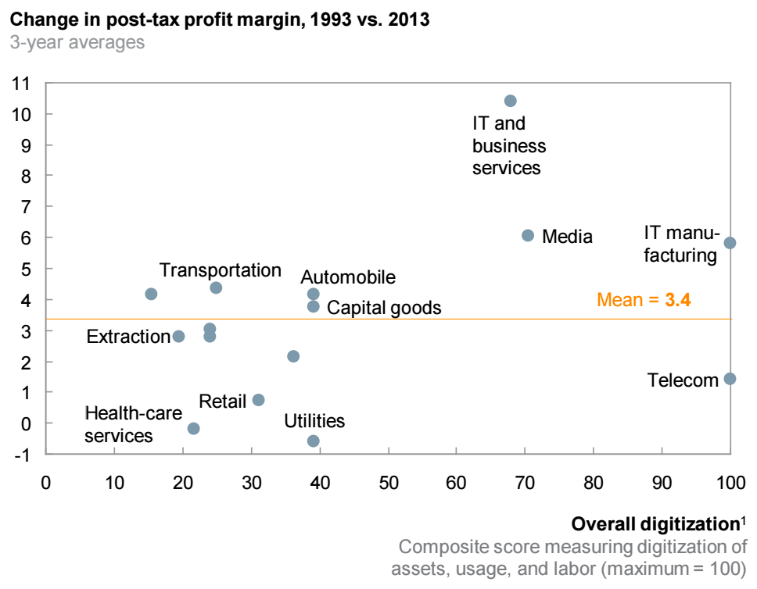
Where is Healthcare Digital Index?
“Healthcare CEO, what is your Digitization Index?”
Data Assets x Data Usage x Data Skilled Labor
Healthcare is one of the least digital sectors, and it shows in profit-margin growth.
Source: McKinsey Corporate Performance Analysis Tool; BEA; McKinsey Global Institute analysis

Slide 6
Digital Experience

Slide 7
Digital Experience Part 1 Placing Orders

Slide 8
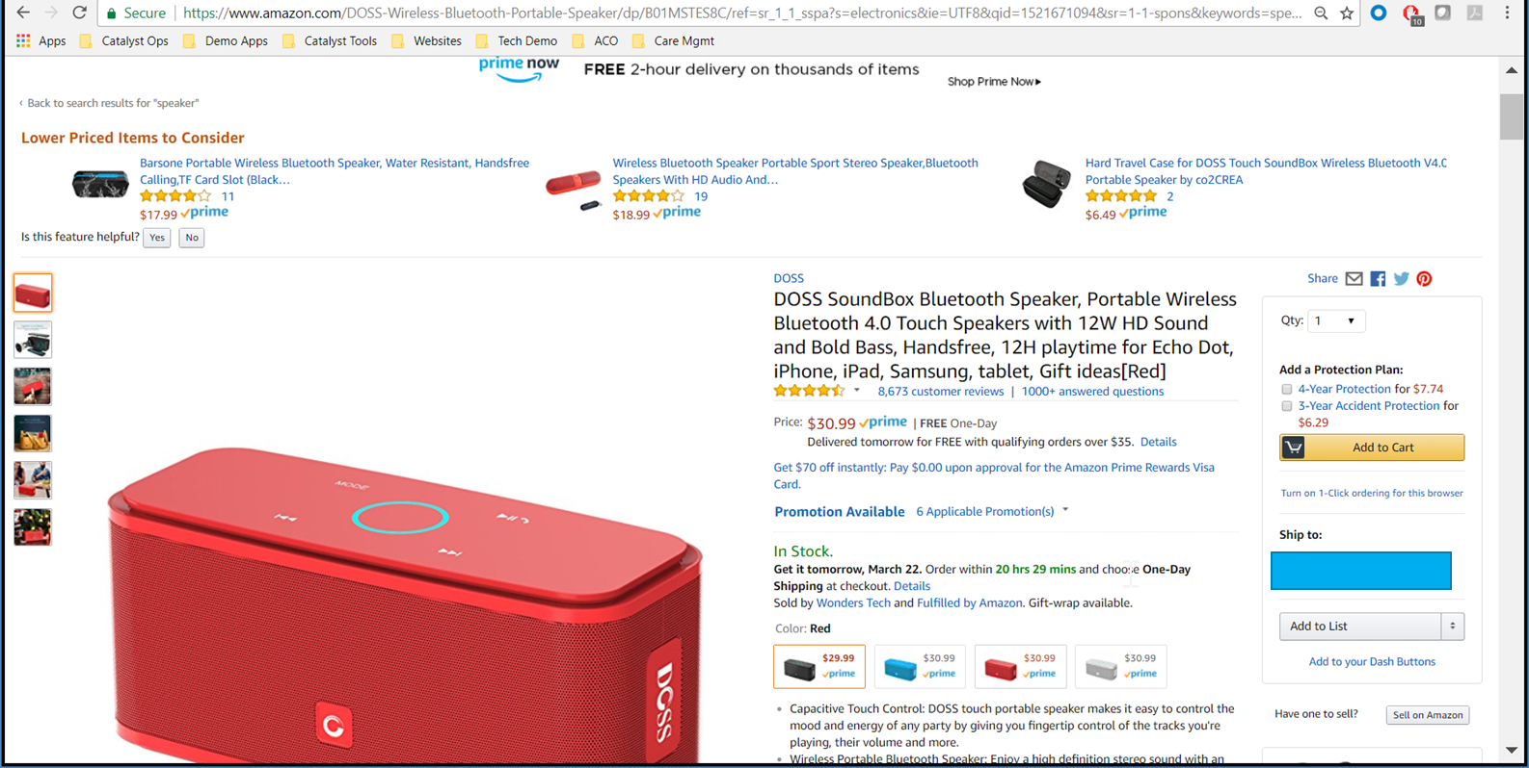
Ordering a Speaker in Amazon.com
Estimated Delivery
Cheaper Options
Feedback loop
Peer Reviews
Cost

Slide 9
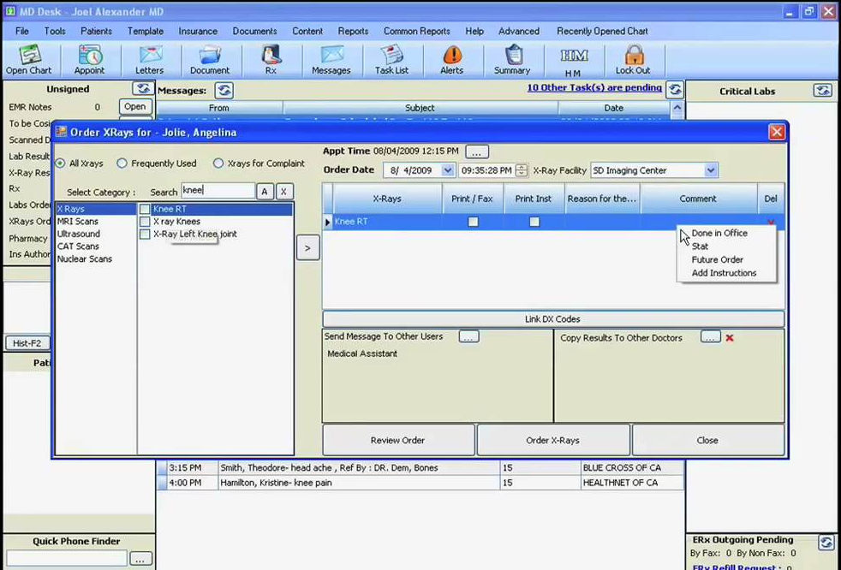
Ordering Asthma Action Plan in EMR

Slide 10
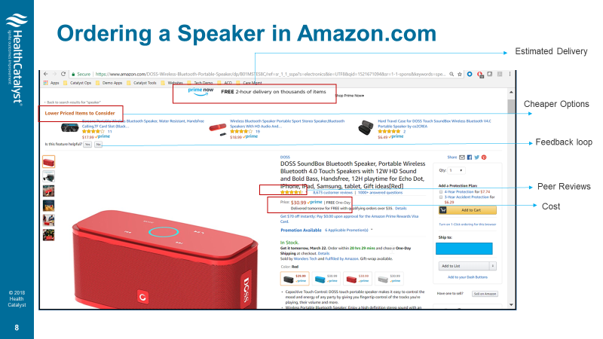
What is the difference?
VS
‘Data First’
Experience
‘Process First’
Experience

Slide 11
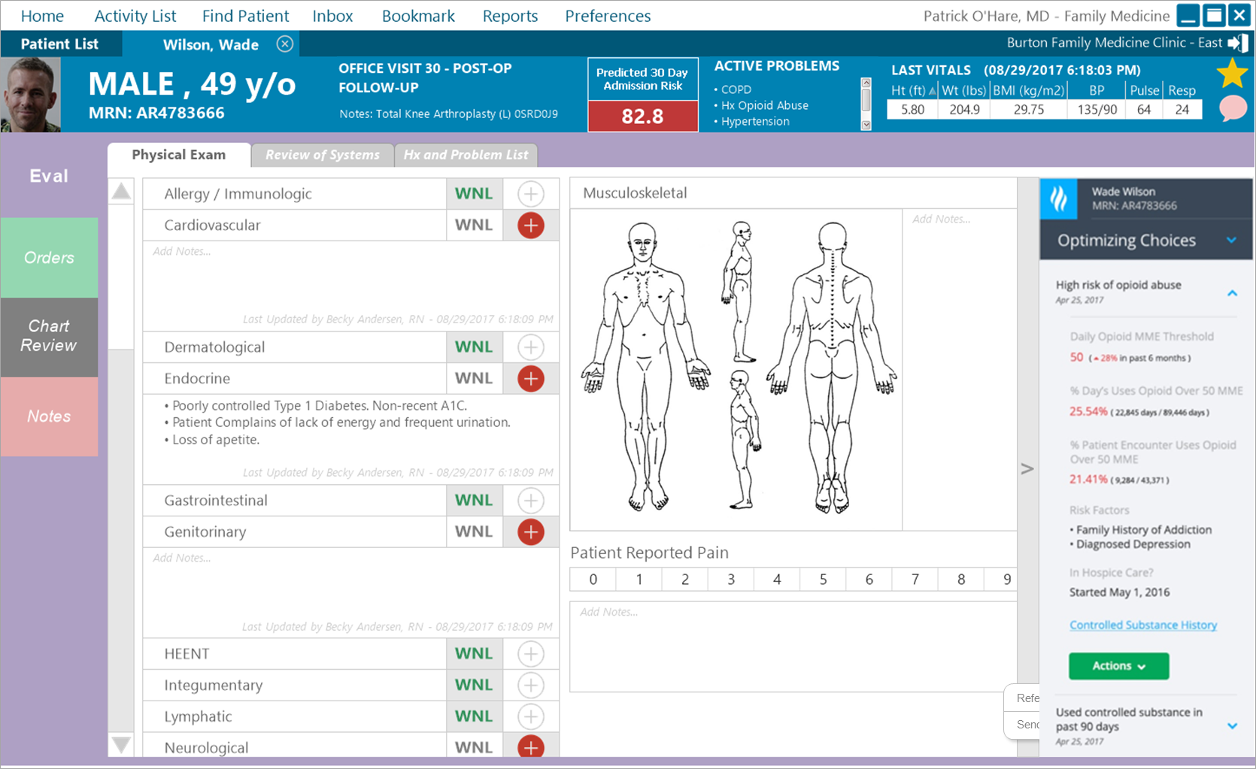
Ordering Asthma Action Plan in EMR
Predicted Risk Score
‘Choosing Wisely’
How likely are clinicians to follow care recommendations if they are in an EHR vs reports.
15x
Recent Orders

Slide 12
Digital Experience Part 2 Scheduling Visits

Slide 13
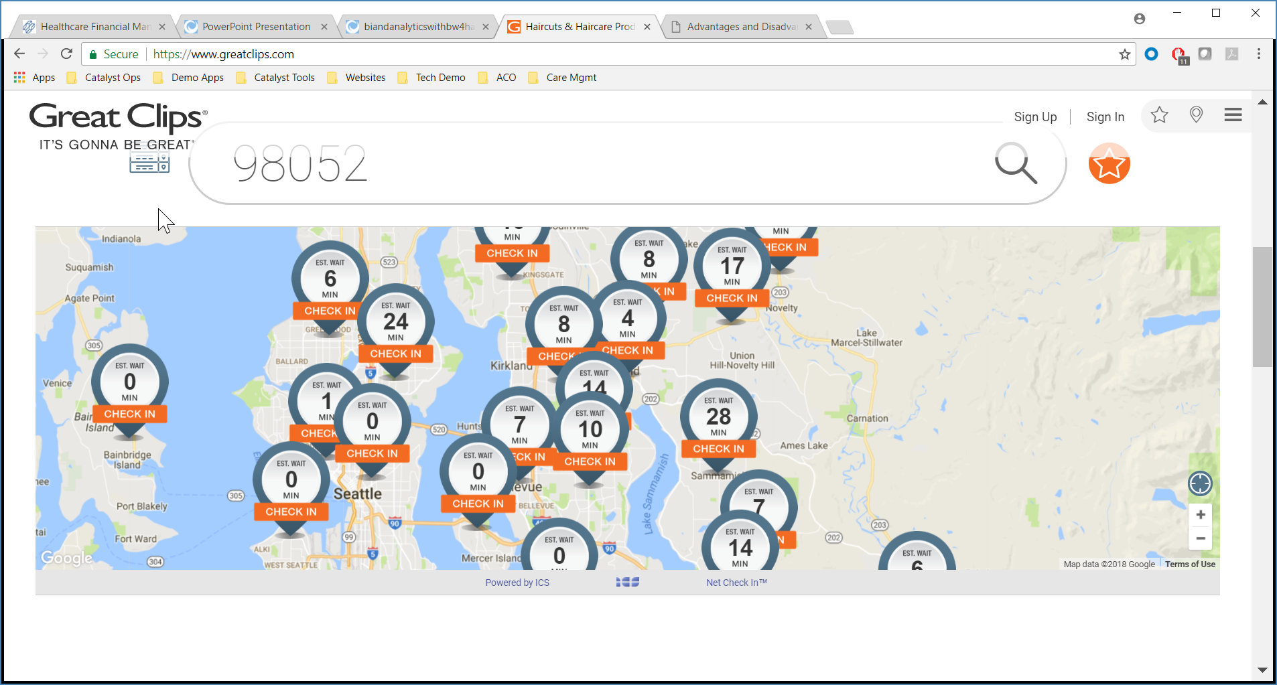
Scheduling ‘Hair Cut’ Visit

Slide 14
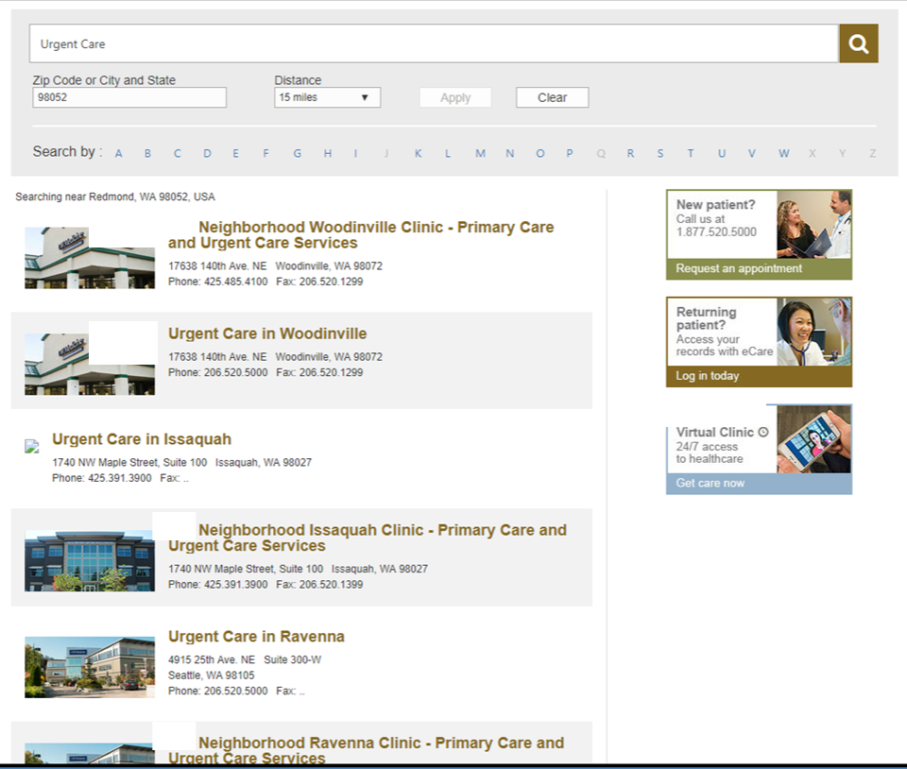
Scheduling ‘Urgent Care’ Visit

Slide 15
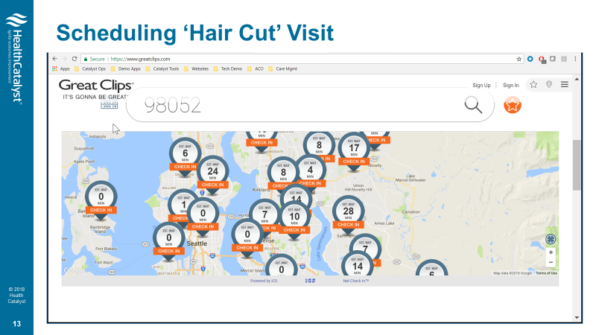
What is the difference?
VS
‘Data First’
Experience
‘Process First’
Experience

Slide 16
Digital Experience Part 3 Switching Providers

Slide 17
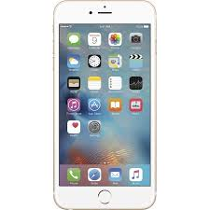
Switching Networks
206 – XXX - XXXX

Slide 18
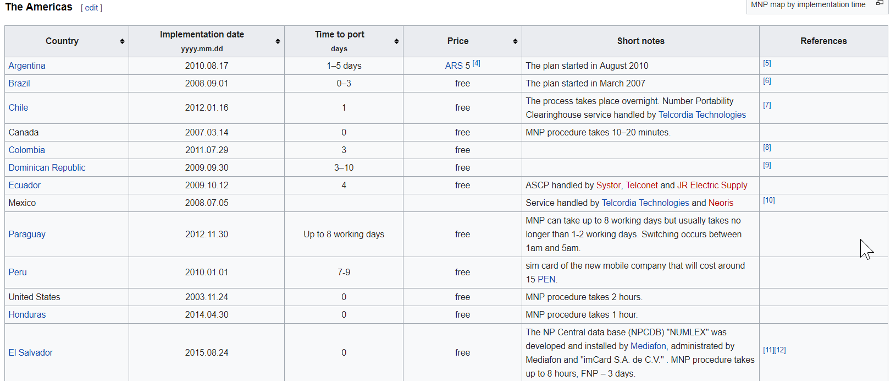
Switching Networks
206 – XXX - XXXX
MNP – Mobile Number Portability

Slide 19
Switching Providers
What’s your experience?
Hospital B
Hospital A

Slide 20
What is the difference?
VS
‘Data First’
Experience
‘Process First’
Experience

Slide 21
Key drivers for ‘Data First’ Expereince

Slide 22
Driver : Mergers & Acquisitions
Source : Thanks to Dale Sanders
The new company is not integrated until the data is integrated
HIE’s are not sufficient for data integration… not even close
Rip and replacing EHRs with a single, common vendor is not an affordable strategy
Besides, hybrid vigor is a good thing… you should not put all of your digital eggs in one basket

Slide 23
Driver : Enable a Personal Health Record
Source : Thanks to Dale Sanders
Updated, integrated, shareable, downloadable, transportable
Healthcare data is currently locked in the cage of the health system and the technology of the EHR
DOS

Slide 24
Driver : Providers becoming payers
Source : Thanks to Dale Sanders
The insurance industry is the tail wagging the healthcare dog
Does anyone, other than those in the insurance industry, seriously believe that the current payer/insurance economic model is working?
Critical to the improvement of this situation is the ability for providers to model and assume financial risk, and compete with, or completely disintermediate, insurance companies.
With a Data Operating System, providers have more and better data to model and manage risk than the insurers.

Slide 25
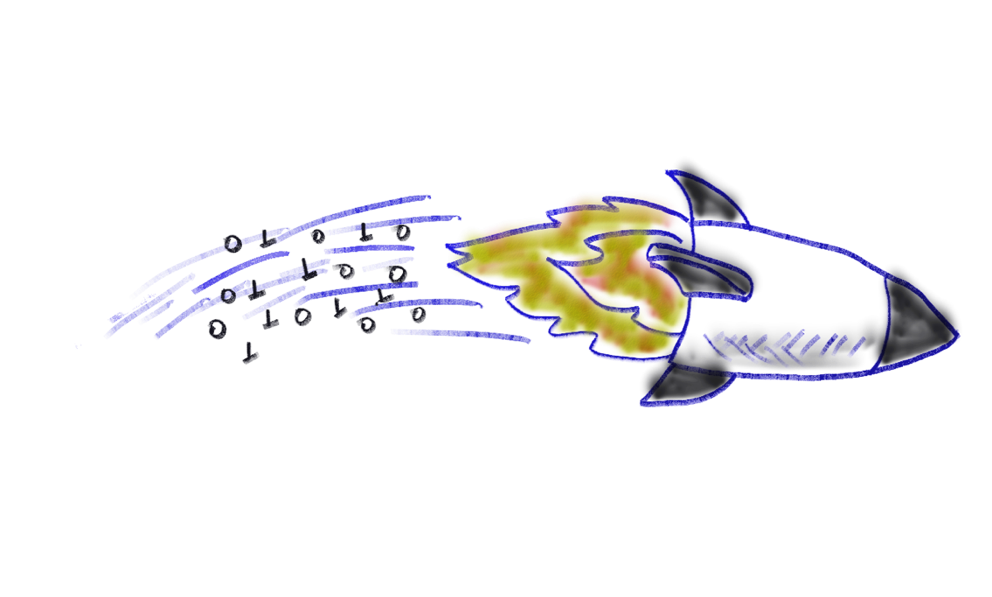
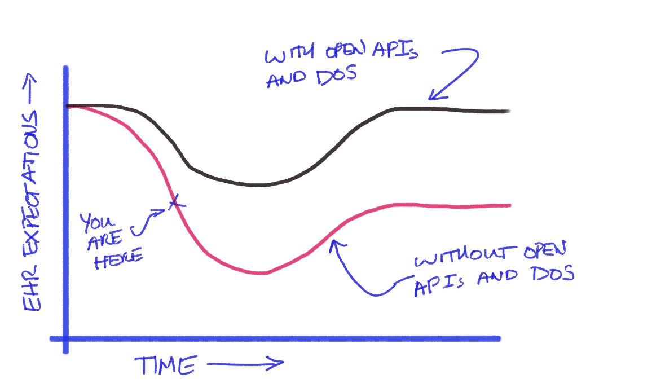
Driver : Extend the life and value of current EHR investments
Source : Thanks to Dale Sanders

Slide 26
Northwest Trend Spotting

Slide 27
Disruptors of Healthcare
98point7
CrossOver Health
‘Data First’ Platform - Data Operating System @ Health Catalyst

Slide 28
Conclusion

Slide 29
Courtesy : Dale Sanders @ Health Catalyst
We’re not satisfied with the
current trajectory of digital health
But, at Health Catalyst, we’re not satisfied with ourselves, either. We are far from perfect.

Slide 30
Digital Disruption is Already Happening
The world’s largest taxi company… owns no taxis
The world’s largest voice/video communications companies… own no telco
The most popular media company… owns no content
The largest lodging company… owns no property
The world’s most valuable retailer… owns no inventory
The world’s largest software vendors… don’t write the apps
Thanks for the inspiration, Ron Kalifa of Worldpay

Slide 31
The world’s largest and most successful healthcare and health management companies, will own no hospitals
In the Digital Future of Healthcare…

