Slide 1
Integrating Care in Washington to Drive Down Costs and Improve Health Measures

Slide 2
Leanne Berge, Esq. Chief Executive Officer Community Health Plan of Washington

Slide 3
Overview
Background and Vision
Integrated Managed Care
Results and Outcomes
Success Stories
Questions?

Slide 4
We are a local, Washington-based Health Plan with long-established ties to communities throughout the State and well-equipped to facilitate and coordinate with local resources on behalf of our members.
As a not-for-profit company, we make decisions that are motivated by the best interests of our members, providers and communities within the State of Washington. We are governed by community organizations (Community Health Centers) that are in turn governed by individuals that receive care within those organizations.
The health of our members is our primary concern. Our programs are designed to proactively identify and address the behavioral, social, and medical needs of our members and to recognize the whole person’s needs.
The vision of CHPW is to provide services and supports that impact the health and well-being of our members, both directly and through our valued partnerships with community-based providers. We meet this challenge by identifying and addressing needs that impact the health of our members both within the clinical setting and beyond.

Slide 6
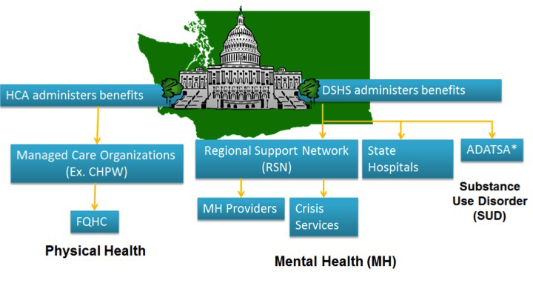
Systems Prior to Integrated Managed Care

Slide 7
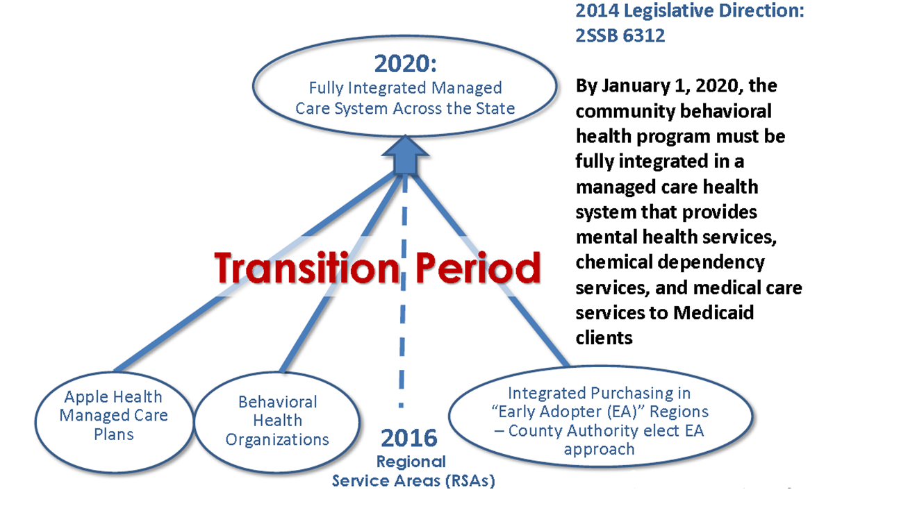
What is Integrated Managed Care
Senate Bill 6312 directed the integration of behavioral health care (mental health and substance use disorder) with physical health care.

Slide 8
Transition to Integrated Managed Care
2015
Transition Period (2016)
2020
Prior system
Early Adopter
Behavioral Health Organization (BHO)
Integrated Managed Care system
Separate purchasing
-HCA contracts with MCOs for physical health
-DSHS contracts with RSNs for MH
-Fee-for-service SUD
Joint purchasing
HCA contract with MCO for:
- Physical Health
-MH
- SUD
Separate purchasing
-HCA contracts with MCOs for physical health
-DSHS contracts with BHOs for:
- MH
- SUD
State purchasing across Regional Service Areas (RSAs)
HCA contracts with MCOs for:
- Physical Health
- MH
- SUD

Slide 9
From Apple Health to Apple Health IMC
Contract | Services
MCO Apple Health Contract - present | Primary Care Specialty Care Hospital Pharmacy (including BH Rx)
MCO Integrated Managed Care Contract | MH Inpatient E&T Residential MH High intensity treatment Day support Group Treatment Services Family Treatment Intake Medication Management Medication Monitoring Rehab Case Management Community Psych Services Peer Support Therapeutic Psychoeducation WISe PACT | SUD Assessment Detox Outpatient Outpatient- Group Opiate Sub Treatment Residential
Behavioral Health-Administrative Services Organization (BH-ASO) | Crisis Services BH Services for non-Medicaid Mental Health Ombudsman Federal Block Grants

Slide 10
Services not included in MCO Contracts
Crisis services for all members of the community
Includes DMHPs
State-funded services for Non-Medicaid beneficiaries
County-funded services for Medicaid and Non-Medicaid
Miscellaneous
BH Ombudsman
Committees formerly led by BHO – WISe, CLIP, Behavioral Health Advisory Board, etc.

Slide 11
Better access to medical care for people living with chronic mental illness
Medical care embedded in behavioral health settings
Better coordinated care through partnering with community providers; improved exchange of information
Better access to behavioral health care
Behavioral health embedded in primary care settings
Strategic investment of total health care dollars to improve total outcomes and cost of care

Slide 16
Collaboration between MCOs and BH-ASO
Bi-weekly operational meetings; clinical information exchange; strategic planning
Behavioral Health Planning Council
Cross system vehicle for system improvement planning
Clinical Alignment Group
MCO/BH-ASO collaboration to align clinical processes and standards
Reporting and Monitoring “Early Warning System” Indicators
Including claims payment and denials, grievances, ED visits

Slide 17
20 Community Health Centers with more than 130 clinics
More than 2,500 Primary Care Providers
More than 14,000 Contracted Specialists
Behavioral Health Network state wide
More than 100 hospitals
Southwest Washington
IMC Region
Presence in 37 of 39 counties

Slide 18
Integrated financing is a fundamental step to support clinical integration at the practice level.
Strong evidence supporting integrated care delivery to effectively address co-morbid conditions and deliver holistic care.
Almost 75% of Medicaid enrollees with significant MH and SUD had at least one chronic health condition
29% of adults with medical conditions have mental health disorders
Americans with major mental illness die 14 to 32 years earlier than the general population, often due to untreated physical health conditions
Clients can access the full complement of coordinated medical and behavioral health care services and supports, through a single MCO.
In SW WA, 10 of 19 outcomes measured in the first year showed statistically significant improvement, relative to other regions. (https://www.hca.wa.gov/assets/program/FIMC-preliminary-first-year-findings.pdf)
MCO contracts require coordination with county-managed programs, criminal justice, long-term supports and services, tribal entities, etc. via an Allied System Coordination Plan.

Slide 19
For Apple Health Blind Disabled population, where we (CHPW) see greatest prevalence of BH conditions:
Emergency room utilization rate decreased by 14%.
Inpatient medical utilization rate dropped by 30%.
Measures show positive benefits for patients:
Patients in IMC region experienced:
Significant increase (8%) in Antidepressant Medication Management, both short term and long term, compared to regions statewide.
Increase in Medication Management for People with Asthma, significantly higher than the previous year state average and higher than overall statewide rates.
*Data Source: Apple Health BD population data - CHPW’s monthly Cost & Utilization Report, comparing April 2016 – March 2017 (paid as of July 31, 2017) to April 2015 – March 2016; Positive measures for patients - Analysis of IMC specific HEDIS Measures

Slide 20
Profile:
45 year old male referred to CHPW case management after calling the Regional Crisis Line.
Suffers from chronic pain due to arthritis, degenerative disc disease, significant depression and panic attacks.
Evicted from mobile home, became homeless without family/friends. Income of $753 per month.
Case Management Interventions:
BH Case Manager (CM) and therapist care coordination for member needing extra therapeutic support and coaching on self-care techniques.
CM connected with Community Health Worker (CHW) who met member at Council for the Homeless to provide support in completing extensive assessment/application for housing, and met with member regularly to arrange shelter and storage of belongings and moving assistance.
Outcomes:
Member received 3 months stay at a family shelter & then moved to his own low-income apartment with handicapped access. His dog was accepted too.
1st time apartment in almost 19 years. Received low cost furniture at Re-Store and Community Warehouse.

Slide 21
Profile:
34 year old refugee from Somalia who lives with her husband and 3 children in a low income apartment in Seattle.
Suffers from epilepsy
Often missed her medication for seizures due to lack of available transportation, language, and cultural gaps.
Case Management Interventions:
CHPW helped her to receive a referral for home delivery of medications so she would not miss a day.
CHPW CM accompanied her to her doctor appointments to make sure that her needs were being communicated and that additional care was being facilitated.
Outcomes:
Member now takes her medication every day and has seen a decrease in seizures.

Slide 22
Questions?

