Slide 1
From Individual Care to Machine-Learning: The Power of Patient-Provider messaging
Anne Weiler
CEO and co-founder
Wellpepper, Inc

Slide 2
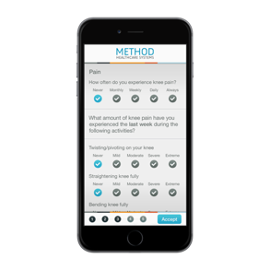
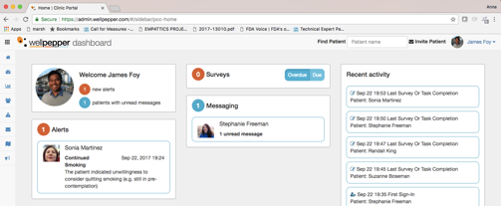

Deliver The New Patient Experience
Enterprise platform & marketplace for interactive care plans
clinically-validated to improve patient outcomes
Anne Weiler
CEO and Co-Founder
Notes:
Hi I’m Anne Weiler, CEO and co-founder of Wellpepper, a clinically-validated platform for interactive patient care plans that drive over 70% patient engagement. We improve patient outcomes and experience, lower costs, and increase access to care. What’s unique about Wellpepper is our architecture that enables any type of care plan including the health systems own, and the delivery of that care plan through the best modality for the patient including mobile, sms, web, and voice.
Patient engagement is estimated at a $17B market, but we think it’s much bigger than that. Today I’d like to share our vision for patient engagement and why we’re the right company to deliver it.

Slide 3
Learning Objectives
Methodology for applying machine-learning to patient-provider messaging
Apply the concepts of a behavior change model to patient-provider messaging
Understand the framework for evaluating the ROI of patient-provider messaging in your organization.
Identify where patient-provider messaging would have clinical impact in your organization

Slide 4
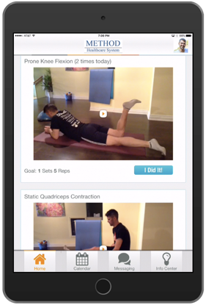


Terry Ellis, PT, PhD
Director, Center for Neurorehabilitation
Tamara Deangelis, DPT, Senior PT
Notes:
Discuss research studies conducted at Boston University exploring use mobile health technology with a messaging feature to enhance care in outpatient rehab. Describe findings from an analysis of all the messages from both provider and patient.

Slide 5

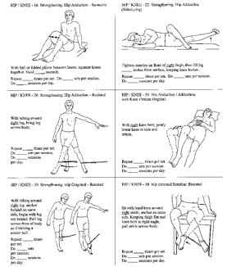
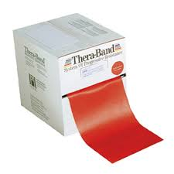
Traditional Model of Care
Outpatient Rehabilitation
Notes:
Traditional care in outpatient rehab consists of a 6-12 week episode of care with 1-2 visits per week and a discharge exercise plan. There is generally no follow up with the physical therapist to monitor pt adherence to the program or adapt the program in anyway. This model that might be suitable for a 25 year old after an acute ankle sprain does not work for those with chronic conditions or older adults that are at risk for mobility decline.

Slide 6
Traditional Care Model: Outpatient Rehab
0
1
2
3
6
months
12
24
PT visit
Notes:
This is what it generally looks like, a cluster of visits early then pt is in the care of a PCP, but no further follow up with the physical therapist. In terms of medicare coverage, this amount of PT will bring them to their CAP or allowable spending limit for PT.

Slide 7
What happens after an episode of care in the Traditional model?
LOW ADHERENCE TO HOME
EXERCISE PROGRAMS
DECLINE IN MOBILITY
LOST TO FOLLOW UP
Notes:
Ultimately, what happens to these patients after that episode of care?…. They stop doing their exercise programs because of pain or travel or moving or the birth of a grandchild. Then they never return to it. We felt like we could do this better so we partnered with a technology company, wellpepper, to improve patient engagement and outcomes with the use of an exercise app for our at-risk patient populations. We knew that one of the key ingredients would be staying connected between episodes of care
If you think about it in terms of cost, we didn’t need to spend as much time and resources trying to get new business if we can maintain the business that we have.

Slide 8
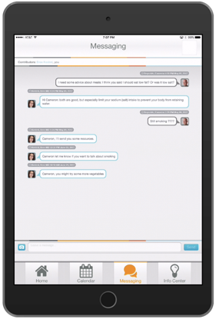
Technology Supported Care Model
0
1
2
3
6
months
12
24
PT visit
Notes:
So, it looked more like this, smaller numbers of visits from the start, spread out over a longer period of time with the focus on early use of the technology to enhance the patient experience.

Slide 9
Driving Behavioral Change with Mobile Technology
Targets of Intervention | Goal Setting and Action Planning | Tailored Exercise Videos | Remote Changes to Exercise Program | Automated Reminders | Monitoring Adherence and Progress | Progress towards Goals | Motivational Content in Messaging (videos) | Messaging with PT
Sources of Influence in Developing Self-Efficacy | Mastery Experience | Vicarious Learning + Mastery Experience | Mastery Experience | Mastery Experience | Mastery Experience | Mastery Experience | Vicarious Learning | Social Persuasion + Interpret Physiologic States
Target of Intervention | Goal Setting and Action Planning | Tailored Exercise Videos | Remote Changes to Exercise Program | Automated Reminders | Monitoring Adherence and Progress | Progress towards Goals | Motivational Content in Messaging (videos) | Messaging with PT
Sources of Influence in Developing Self-Efficacy | Mastery Experience | Vicarious Learning + Mastery Experience | Mastery Experience | Mastery Experience | Mastery Experience | Mastery Experience | Vicarious Learning | Social Persuasion + Interpret Physiologic States
Notes:
In our clinic visits, we take a patient-centered approach and work in partnership with people to establish goals and outcomes expected from exercise, in order to help increase their self-efficacy. we focus on helping our patients develop self-efficacy because we know that people with high self-efficacy are more likely to engage exercise even when they perceive that there are barriers (time, weather) so it would be make sense to include this approach in the technology we use.

Slide 10
mHealth (Parkinson disease)
REACH (Rehabilitation Enhancing Aging through Connected Health)
RCT
Exercise intervention over 12 months
1-2 Clinic visits
Quasi experimental design
Exercise intervention over 12 months
6-16 Home and Clinic visits
Notes:
REACH Rehabilitation Enhancing Aging through Connected Health
Mhealth (25 active control and 26 experimental)

Slide 11
Results
Mobile health intervention
Notes:
This is data from our mhealth study with people with Parkinson disease using the mobile health technology vs no intervention. From previous studies we’ve done, we know that there is a 12% decline in physical activity as measured by steps in people with Parkinson disease who don’t engage in regular exercise. Unfortunately, we do not yet have the data from the REACH study, older adults at risk for mobility decline. This study also looked at medicare claims data so we will be able to report on whether or not the mobile health intervention has an impact on overall healthcare costs during the time subjects were in the study.
How did we keep these patients engaged for a year with only 1-2 in person visits to start? Here’s a little more about our approach.

Slide 12
Clinician-Initiated Communication Triggers
  No activity in >7 days
  Pain reports on exercise greater than 2/3
  Fall report
  Change in overall exercise behavior
  Check-in (Is it boring? Too easy? Too much?)
Notes:
We would reach out to them under certain circumstances to work on keeping them engaged in the technology which was, in some cases, not part of everyone’s every day life. We had certain triggers that would prompt us to reach out through the messaging feature to reconnect.
“hey bob, you had been doing your squat exercise five times per week and I’m noticing that in the last couple of weeks your have been doing it less frequently. Let me know if you are having difficulty with that exercise” and we might have a conversation about how he thinks it’s the hardest one, gives me the opportunity to talk about why I think this particular exercise will help him when he travels to France in the Spring and wants to walk on his own in the airport.

Slide 13
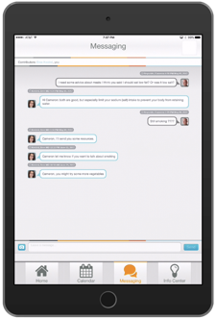
Patient-Initiated Content Examples
I didn’t do my exercise this week because..
I am going on vacation and don’t want to bring the iPad.
I forgot to enter my exercises but I did them!
I also did ____ today for exercise.
Notes:
Most of the time, patients were answering my questions or just adding a bit of extra info….usually making sure they got credit!

Slide 14
Usage Patterns and Practices
Not used for urgent messages
Agreed upon frequency of checking messages
Not all messages require a response from the therapist
One-sided messaging from therapist
Notes:
We were upfront up the role of messaging in the study from the start..it wasn’t texting, there wouldn’t be an immediate response. The therapist would check the messages most days but not every day. If you needed help urgently, you should always call.
In our experience, messaging wasn’t opening Pandora’s box to over communication by patients. It was a status check or a quick update, and excuse or letting your therapist know about a success. Many of the messages didn’t require a response or in our second study with more visits, had information that could be acknowledged or discussed at that time. Wellpepper analyzed our messages to support what we had found and see if we could gain more insights from it to scale care in the future.

Slide 15
Insights from Machine Learning
Anne Weiler

Slide 16
Enabling & Scaling Patient Interactions
Tasks
Enable
Communication
Outcomes
Triage Rules
Suggested Actions
Empower & Scale
ML
Auto Assign
Recommendations
Exception Workflows
Automate
Escalations
Notes:
Create a communication channel
Empower patients and providers by triaging importance and suggesting actions
Automate care based on learnings from people interactions and machine learning.

Slide 17
Urgent Message Classifier
Automatically identify urgent messages for faster triage
Urgent: “I have bad news! I fell on the ice Sunday and sprained my left wrist and bruised my tailbone. It is very painful.”
Not Urgent: “Easier with shoes on than barefoot”
Dataset:
~800 patient-generated messages
Labeled Data:
Manual
Implicit
Labels:
Urgent
Complaint
Question
Technology
General
Notes:
Message dataset includes study data and data in the wild
Implicit labels: Speed of viewing, and response or response time.

Slide 18
Urgent Message Classifier
Evaluated machine learning techniques (Naïve Bayes, Support Vector Machine, Neural Networks)
Support vector machine worked best
Challenges
Urgency is subjective
Word-frequency models miss semantic meaning
Labeling sensitive data (potentially containing PHI) is hard
Further Study
Multi-class discrimination (e.g. urgent because of pain vs urgent because of a complication, etc.)
Larger datasets
Semantic meaning
Results
Overall accuracy 74%
 | Classified as Urgent | Classified as Not Urgent
Actually Urgent | 50 | 24
Actually Not Urgent | 26 | 90
Notes:
python TextBlob sentiment analyzer uses data from a movie review corpus to train a Naive Bayes model. Naive Bayes is just a type of ML model.

Slide 19
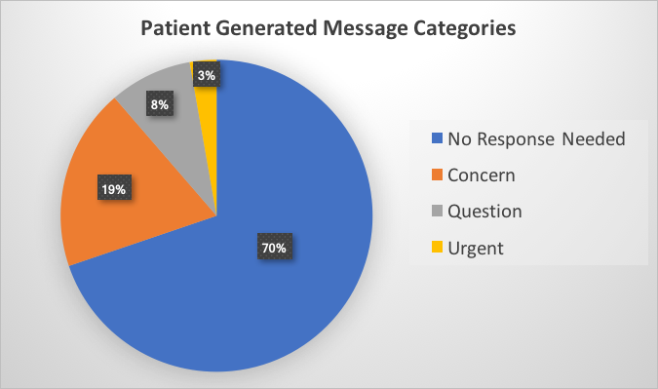
Notes:
Take all these messages and classify them, starts with a human going through all 800 and identifying if they were from patient or provider, if they were urgent or not etc. It turns out, most did not require a response, Beyond that 70%, a response was required but only for the questions and concerns and it could be within a week or so. The urgent messages, which were only about 3% were the only ones that required an immediate response.

Slide 20
Messaging Analysis of Clinical Trials
Examine sentiment of both patient and provider messages
Determine frequency of patient/provider messages
Understand relationship between outcomes and frequency of messaging
Notes:
What did we find out? Outcomes and frequency…this is important because we want to know how much effort you need to put in to keep someone adherent to their exercise plan. Sentiment is important because we want to know how patients are feeling while engaging in the system and with the provider. Is this a positive experience?

Slide 21
Example Polarity
1.0 "Feeling great!"
1.0 "By the way, great job with the exercises this week!"
1.0 "Great job on your walking! The weather has been perfect for this."
0.85 "Good job with your stretches and exercises yesterday. Have a great week!"
0.8 "Looks great Nicole. Remember to keep your hips level."
0.8 "No, I haven't experienced either pain or soreness.
In fact, I'm wondering about adding another exercise or two."
0.8 "She's happy while performing this exercise"
0.75 "Fatigued is ok! Keep up the good work!
0.75 "I am Soo BEAT from Wednesday:(”
-0.75 "Got the stomach flu today so am not doing well on exercises :(”
-0.75 "Lost my fitbit :(”
-0.8 "I hate this”
-0.8 "Hate doing step exercise”
-0.85 "My hips are burning so bad. This one is horrible!”
-1.0 "Evil. Twice a day....twice as evil."
Notes:
Start out with sentiment analysis, most positive and most negative ( no sentiment analysis on healthcare data, this was for a movie review system) Patients were generally neutral to positive, Providers were overwhelmingly positive. This isn’t terribly suprising! I will point out that the last comment, Evil, twice a day….twice as evil! Was a joke, this person was just giving me a hard time!

Slide 22
Notes:
Provider zeros at the bottom of the chart
Patients neutral to positive
This is only for messages from the REACH study.
num patients: 69
total num sent by patients: 3225
total num recd by patients: 1457
total message count: 4682
Again, for the most part neutral to positive for the patients and positive for the providers.

Slide 23
Word Clouds: Positive
Notes:
86.3% of the strongly negative (polarity <= -0.75) messages were sent by patients.

Slide 24
Word Clouds: Negative
Notes:
73.2% of the strongly positive (polarity >= 0.75) messages were sent by professionals.

Slide 25
Notes:
Sentiment change for patients who have sent at least 2 messages. Mostly neutral. Outlier only sent 2 messages.
"Time" is variable, it's based on the patient's first message and last message
Looks at the trend over time of patients' messages
The one is an outlier, a patient who got negative quickly and then didn't message again (I believe it was only two messages)
Doesn't show much, patients seem to stay mostly neutral over time, with most going slightly positive. I would hesitate to draw too many conclusions from this data.

Slide 26
No correlation between messaging and adherence
Notes:
No correlation between adherence and messaging…doesn’t matter that the patient wrote 175 messages and the provider didn’t match message per message. They will continue to be adherent if if they aren’t matched. Pt adherence is driven by other things. Link back to self-efficacy/behavior change

Slide 27
Applications for Machine Learning
Identify patients with high frequency messaging behavior to modify treatment plan
Identify therapist response patterns and create automated responses in therapist “voice”
Identify urgent messages and alert provider to scale care
Notes:
Data can help you quantify what you know intuitively… then start to put dollars behind the effort of doing these things. Start to scale based on the information you draw out.

Slide 28
Messaging Takeways
Not costly
Positive impact for patients
Valuable data that can identify patient issues

